Slide 1

KWEA/KsAWWA
Joint Conference
Impact of Salina’s Military Base Closure…..
Groundwater Contamination
Martha Tasker, Director of Utilities
City of Salina
August 31, 2021

Slide 2
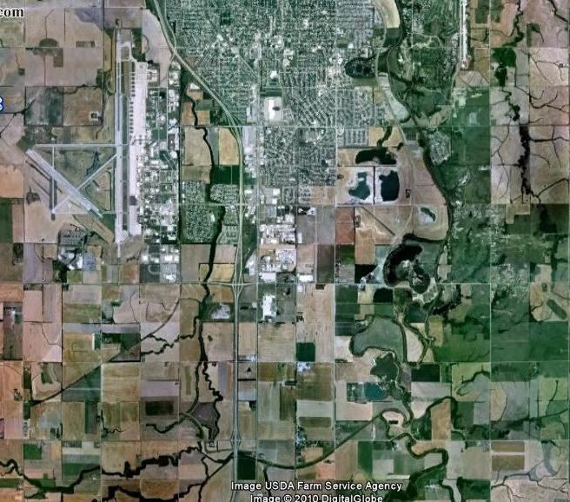
PRESENTATION OUTLINE
  History – Schilling Air Force Base
  Roles and Responsibilities
  Dragun Corporation Contamination Investigation
  KDHE Corrective Action Decision (CAD)
  Dragun Remedial Design
  Discussion/Questions
Schilling Air Force Base Site, Salina, Kansas

Slide 3

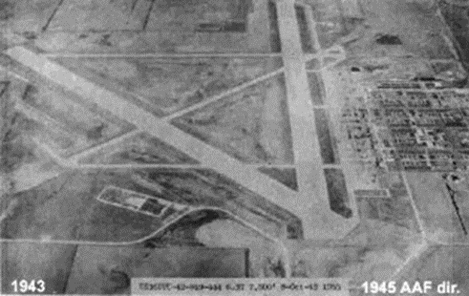
History – Schilling Air Force Base
  1942 Smoky Hill Army Air Base Opens
  1946 Renamed Smoky Hill Air Force Base
  1957 Renamed Schilling Air Force Base
  1965 Base closed
  1965-1967 Base land and buildings transferred to:
    Salina Airport Authority
    Unified School District
    Kansas Education Authority (now the Kansas Board of Regents)
    City of Salina
  From 1942-1967 the military operated the base
  At the time of base closure, there were no environmental laws or regulations
An aerial photograph of the Smoky Hill Army Air Field in 1943.

Slide 4
History – POST Schilling Air Force Base
  1994-1995: Removal of 107 underground storage tanks and associated piping
  1998: Removal of transformer vault and box culvert
  2005 ACOE issues Final Remedial Investigation Report
  2005 Dragun Corporation retained by SPEs to review ACOE data and reports
    Errors found in calculations of groundwater travel time to City water supply wells
    Identified a more urgent need to address the contaminants
  2006: Installation of an air stripper at Salina Area Technical College sump
  2006: Installation of sub-slab ventilation system in classroom building at SATC and KSU

Slide 5
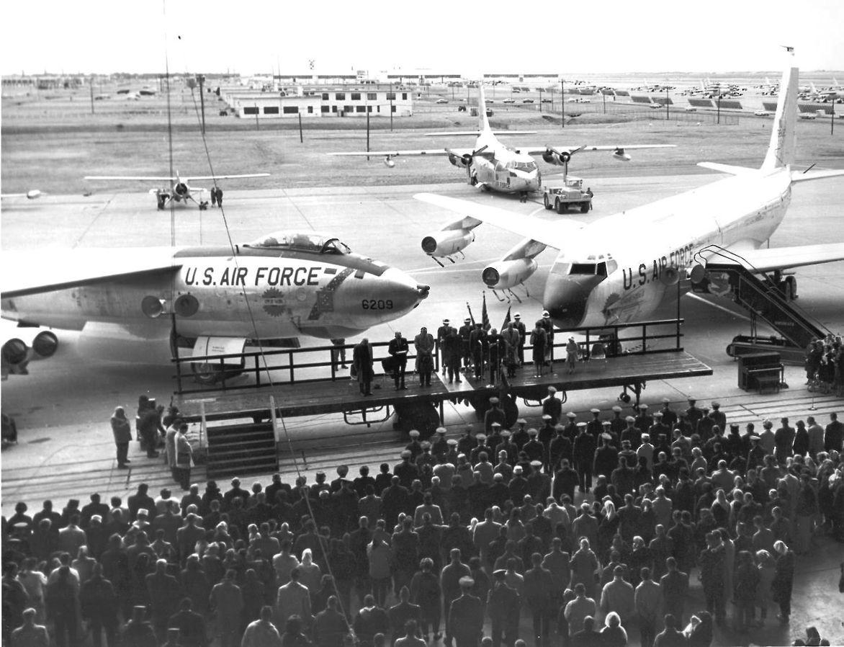
History – POST Schilling Air Force Base
  2007 ACOE approached SPEs about transferring project responsibility
  2007-2008 ACOE conducts supplemental site investigation
  Parties did not agree on all aspects of investigation and remediation
  ACOE monitoring of groundwater
    2006-2011: Monitored 150 wells
    2011-2012: Monitored 20 wells east of I-135
    2006-2012: Monitored 3 private wells
  Military activity impacted soil and groundwater

Slide 6
Roles and responsibilities
  2012 SPEs reached settlement with Department of Justice
    SPEs complete site investigation and feasibility study
    Consent Decree/DOJ
    Consent Agreement and Final Order/KDHE
  2013 Dragun Corporation contracted to provide environmental services
    Remedial investigation of soil, groundwater, surface water, sediment, soil vapors, and indoor air
    Feasibility Study
    Pilot tests
  KDHE Responsibilities
    Oversight of investigation and clean-up
    Ensure protection of human health and the environment
    Develop Corrective Action Decision (CAD)
  Funding = $9,363,000: 90% US Government/10% SPEs

Slide 7
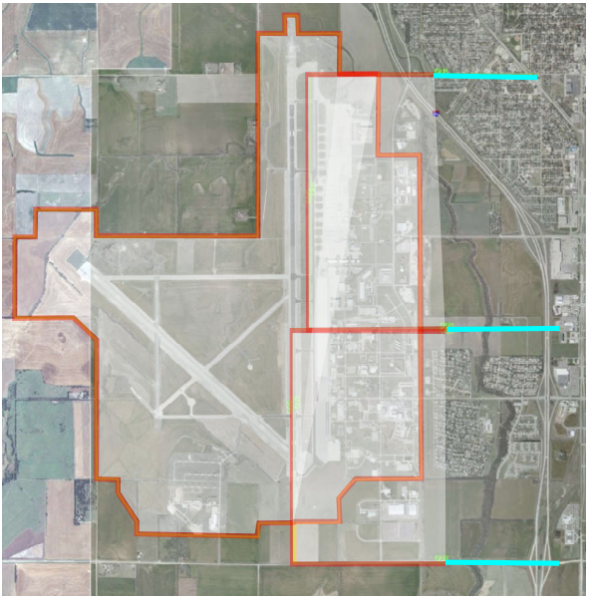
Dragun CONTAMINATION INVESTIGATION
Area with most information
  Environmental Issues
    Use and disposal of petroleum products
    Use and disposal of chlorinated solvents
    Management of waste
OU1
OU3
OU2
Little investigation conducted by ACOE
Least risk
  Very little groundwater
  Groundwater moves slowly
  Access is limited
Little investigation conducted by ACOE
Majority of data >10 years old

Slide 8
Dragun CONTAMINATION INVESTIGATION
  OU1
    Refining soil and groundwater delineation to assist with remedy selection
    Investigation of vapor intrusion to buildings
  OU2
    Identification of sources
    Delineation of groundwater plumes
    Investigation of vapor intrusion to buildings
    Quantification of chemical transport rates
  OU3
    Identification of sources
    Delineation of groundwater plumes
    Quantification of chemical transport rates
    Characterization of surface cover for three historic landfills

Slide 9
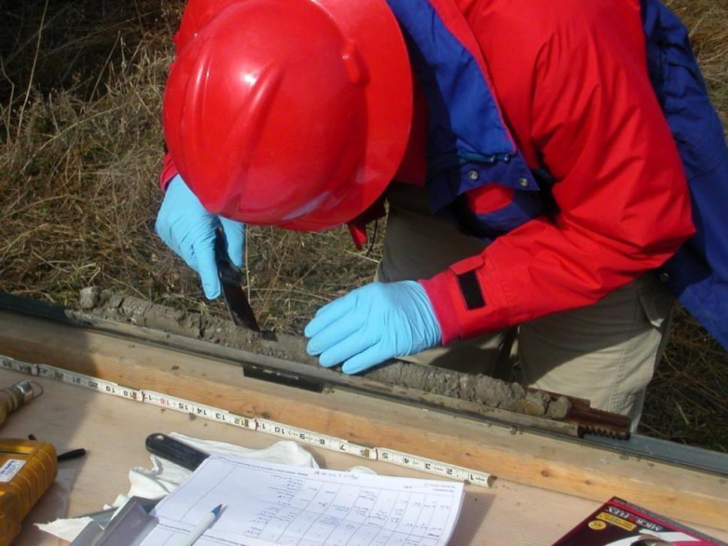
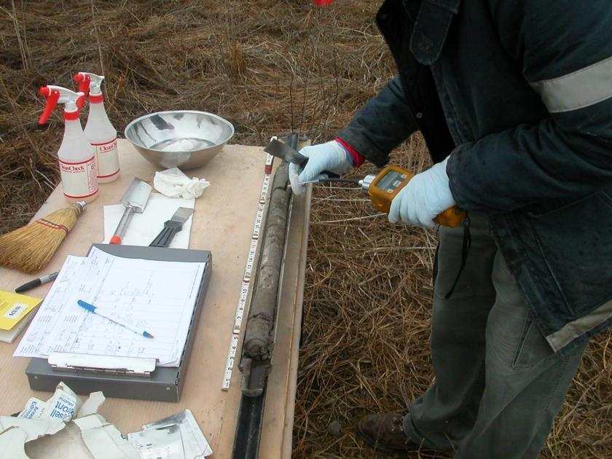
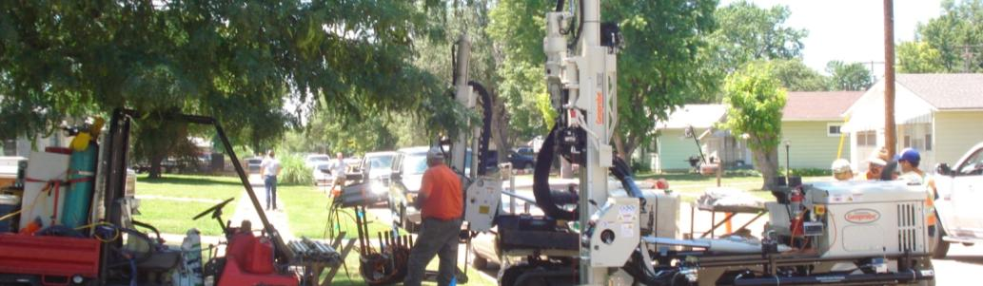
DRAGUN CONTAMINATION INVESTIGATION - SOIL

Slide 10
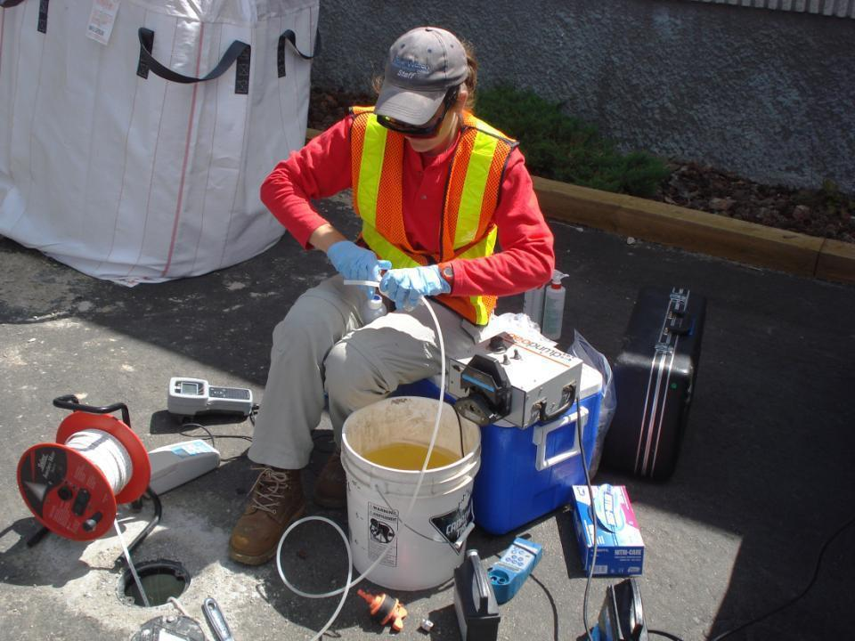
DRAGUN CONTAMINATION INVESTIGATION - GROUNDWATER

Slide 11
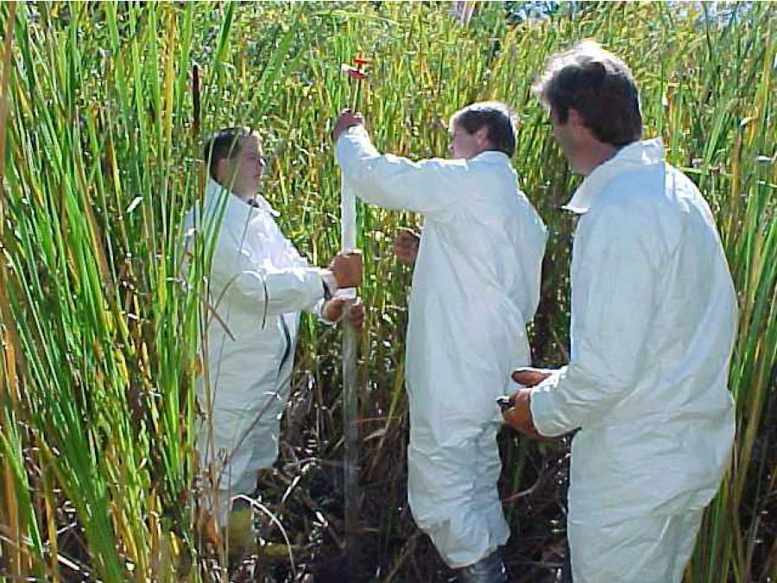
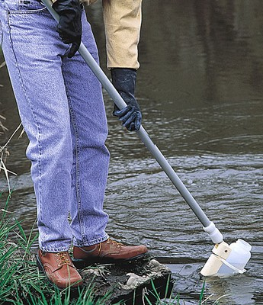
DRAGUN CONTAMINATION INVESTIGATION –
SURFACE WATER AND SEDIMENT
Image source: Michigan Department of Environmental Quality
Image source: Ben Meadows

Slide 12
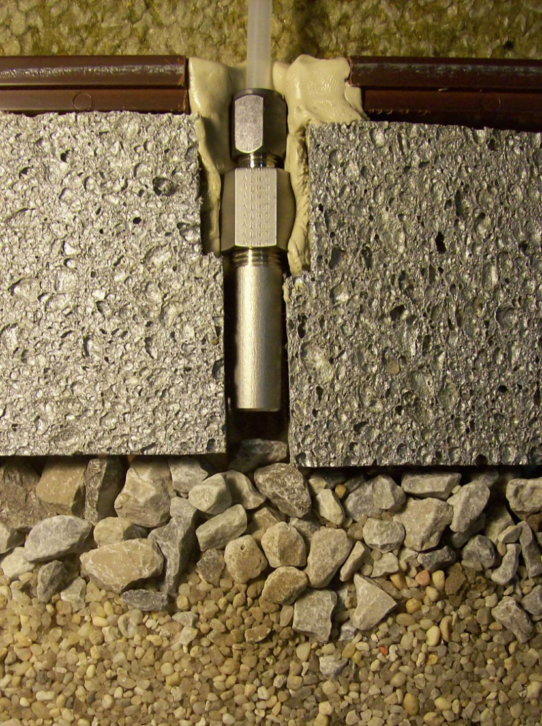
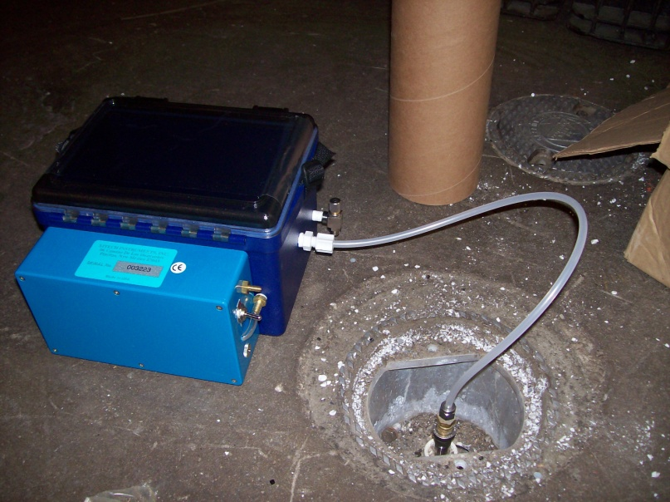
DRAGUN CONTAMINATION INVESTIGATION –
SOIL VAPOR SAMPLING

Slide 13
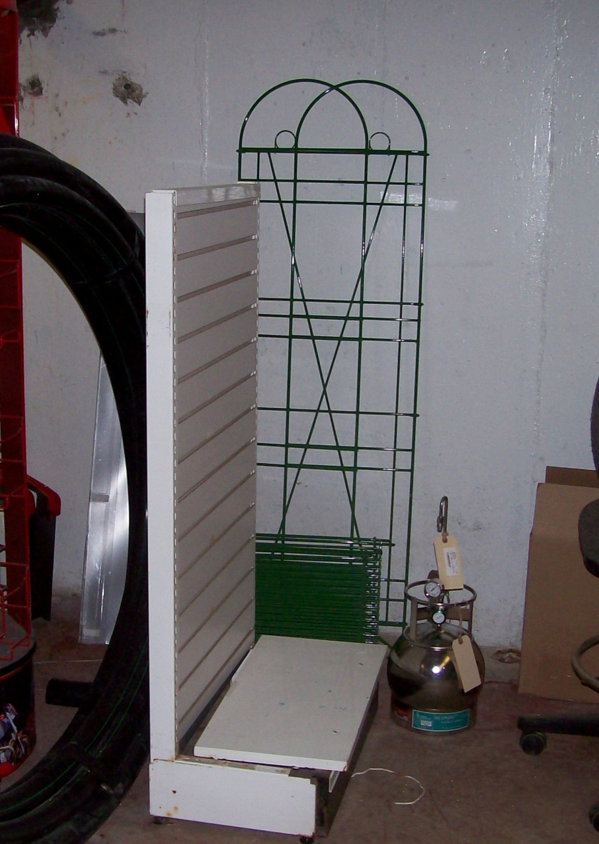
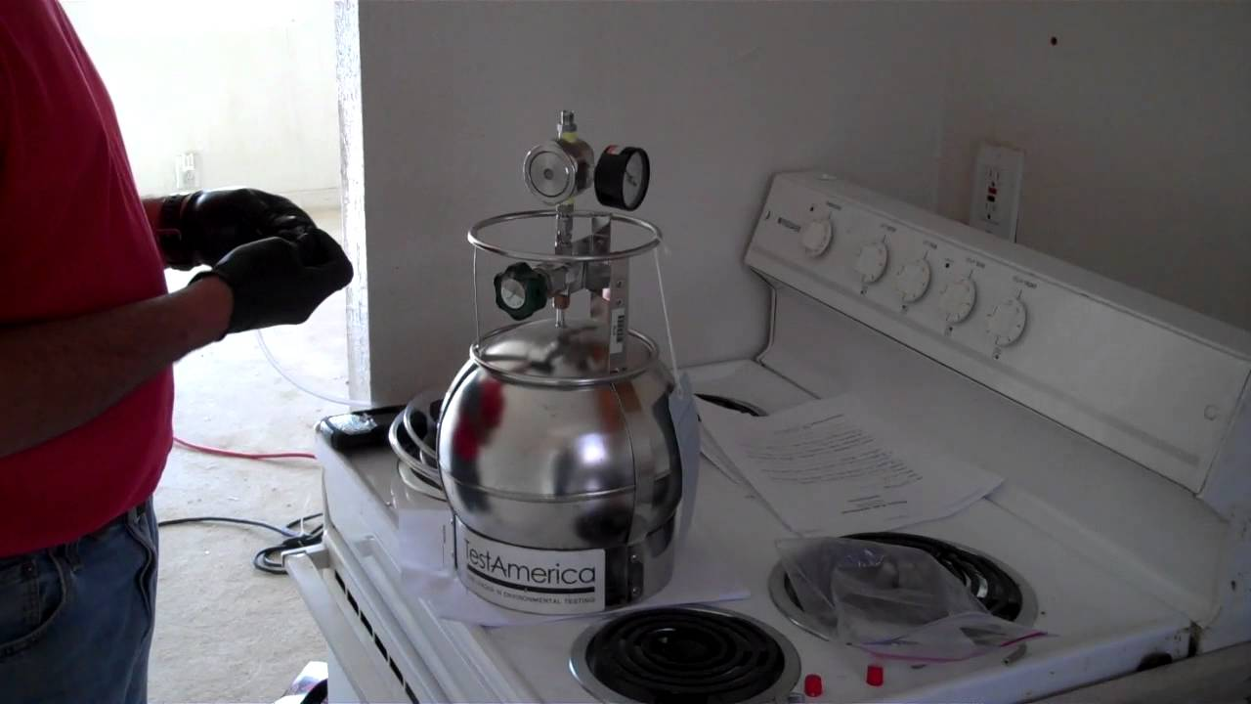
DRAGUN CONTAMINATION INVESTIGATION –
INDOOR AIR SAMPLING

Slide 14
DRAGUN CONTAMINATION INVESTIGATION - SUMMARY
  Investigation Procedures, 2014-2017
    Sampling 149 existing monitoring wells
    Installing and sampling 73 new permanent monitoring wells
    Sampling 207 temporary monitoring wells
    Collecting groundwater samples from 185 screen point wells
    Collecting groundwater samples from 3 pumping wells
    Collecting samples from 3 domestic wells
    Installing over 400 soil borings
    Collecting surface water and sediment samples
    Investigating indoor air samples
Notes:
HPT – hydraulic profiling tool from Geoprobe – helps to find permeable zones

Slide 15
DRAGUN CONTAMINATION INVESTIGATION - SUMMARY
Roles and Responsibilities
  Multiple large volatile organic contaminate plumes
  Trichlorethylene (TCE) highest concentration
  Other contaminants of concern:
    Tetrachloroethylene (PCE)
    Vinyl Chloride (VC)
    Carbon Tetrachloride (CT)
    Chloroform
    Petroleum Compounds
    Metals
    Dichloroethylene (DCE)
    Per and Polyfluroroalkyl Substances (PFAS)

Slide 16
DRAGUN CONTAMINATION INVESTIGATION
HUMAN HEALTH RISK ASSESSMENT
  Contamination Investigation Data
    Potential health risks – with no remediation (Cleanup)
    Direct contact, ingestion, dermal contact, and inhalation
    Current and future workers, residents, students, youth trespassers, recreational users, and farm families
    Cancer risk or Non-cancer risk
  Utilized to Prioritize Remedial Decisions
    Groundwater for the domestic wells (Not used today)
    Future residents exposed to contaminated soil
    Surface soil (0-1’)
    Consuming produce in contact with contaminated soil
    Surface water (Minimal opportunity for wading or incidental ingestion)
    Vapor Intrusion – 54 buildings – Excess hazard one building

Slide 17
DRAGUN CONTAMINATION INVESTIGATION
Remedial Action Objectives
  Media-specific goals established to protect human health and the environment.
    Groundwater, soil, soil vapor, surface water
    Reduce concentrations – protective of all uses including residential drinking water and indoor air criteria
    Prevent ingestion, direct contact, and inhalation of contaminants
    Prevent migration of contaminants
    Remove source of contamination
    Prevent risk and/or hazard exposure of residents and workers
    Treat hot spots of contamination – reduce concentration, volume, or mobility
    Prevent vapor intrusion risk and/or hazard exposure

Slide 18
DRAGUN CONTAMINATION INVESTIGATION
REMEDIAL ACTIONS EVALUATED
  No Action
  Excavation
  Large Diameter Borings
  Thermal Treatment
  Pump and Treat
  Directed Groundwater Recirculation
  Emplaced Permeable Reactive Barriers
  Injection of Permeable Reactive Barriers
  Land Use Restrictions
  Monitored Natural Attenuation

Slide 19
DRAGUN CONTAMINATION INVESTIGATION
Excavation/Large Diameter Borings
  Overburden soil source area will be excavated
  Soil will be temporarily stockpiled, characterized, and then disposed at an appropriate local landfill
  Soil deemed hazardous will be disposed at a special facility that handles hazardous material
  Excavation pit will be backfilled with clean sand and soil, and restored to its original condition

Slide 20
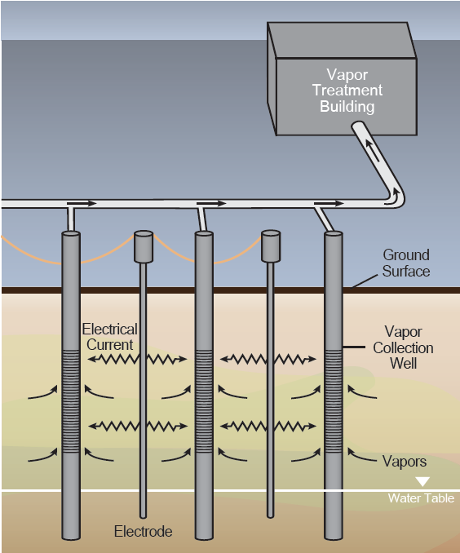
DRAGUN CONTAMINATION INVESTIGATION
Thermal Treatment
  In-situ thermal desorption by thermal conductive heating (TCH)
  Uses heaters placed in underground steel pipes
  TCH can heat the contaminated area hot enough to destroy some chemicals
  Extracted vapors will be treated prior to discharge
EPA, 2012, A Citizen’s Guide to In-Situ Thermal Treatment, EPA 542-F-12-013

Slide 21
Dragun CONTAMINATION INVESTIGATION
Directed Groundwater Recirculation
  Groundwater is extracted via extraction wells, piped to a treatment building, treated, and reinjected back into the aquifer through injection wells
  Treatment technologies include air stripping, carbon adsorption, and ion exchange
  Injection water may be amended with nutrients to enhance in-situ biodegradation
Treatment Building
Air Stripper
Carbon
Ion Exchange

Slide 22
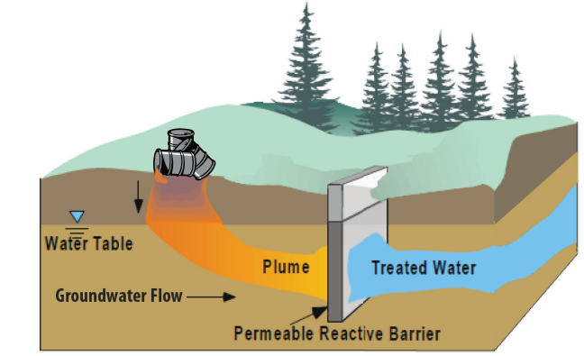
Dragun CONTAMINATION INVESTIGATION
Permeable Reactive Barriers
  A Permeable Reactive Barrier (PRB) is a “wall” of reactive materials created below ground in which groundwater is treated as it flows through
  The material reacts with the contaminants in groundwater to form less toxic or harmless chemicals
  PRBs can be installed by trenching and replacing the original material (emplaced) or by injection of the PRB material into multiple closely spaced points
EPA, 2012, A Citizen’s Guide to Permeable Reactive Barriers, EPA 542-F-12-015

Slide 23
Dragun CONTAMINATION INVESTIGATION
Land Use Controls
  Zoning restrictions, municipal ordinances, or Environmental Use Controls (EUCs) administered by KDHE
  EUC places restrictions, prohibitions, and conditions on land use
  Reduces or eliminates potential human exposure
  Binding on the landowner and any future owners, lessees, and property users
  May require notification, planning, and procedures for handling and disposal of any impacted soil
  Prohibition on the drilling or use of domestic or livestock wells
  Fencing or signage.
  EUC may be placed on the Plume J (Landfill 1) property.

Slide 24
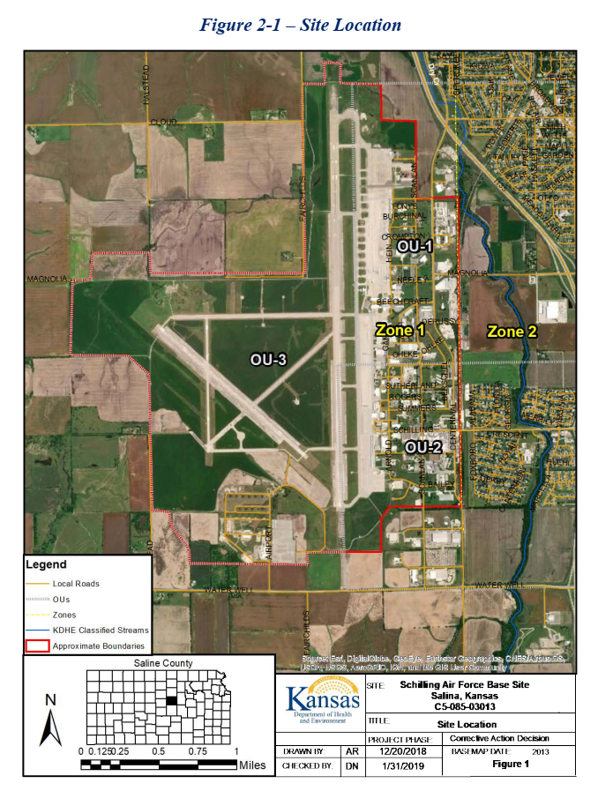
KDHE - CAD
Zone 1
Zone 2
Zone 1 – West of Centennial Ditch – Non-Residential Use
Zone 2 – East of Centennial Ditch – Residential Use

Slide 25
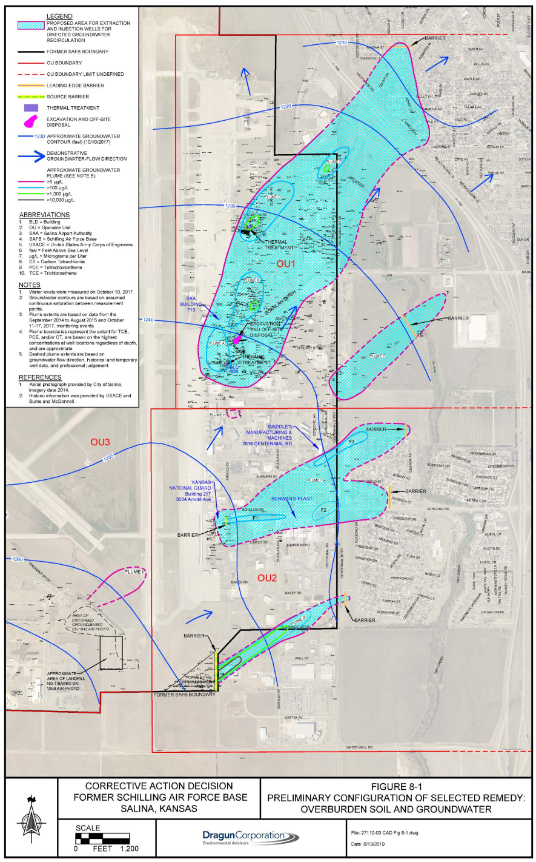
KDHE - CAD
Groundwater
  Multiple TCE plumes - highest concentration 100,000 µg/L
  Soil, surface water, and groundwater analysis - multiple contaminants of the VOCs, PFAS, petroleum compounds, and metals

Slide 26
KDHE - CAD
Cleanup Levels for Soil Target Compounds
Compound | Remedial Goals (µg/kg) | Alternate Treatment Goal (Zone 1) (µg/kg)
Tetrachloroethylene (PCE) | 121 | 1,210
Trichloroethylene (TCE) | 84.2 | 842
cis-1,2-Dichloroethylene | 855 | 8,550
Vinyl Chloride | 20.5 | 205
trans-1,2-Dichloroethylene | 1,220 | 12,200
Carbon Tetrachloride | 73.4 | 734
Chloroform | 850 | 8,500
PFOS + PFOA | Not Established | ----
  Soil contamination at the site may pose an unacceptable risk to outdoor workers or future residents.
  Soil contamination contributes to groundwater contamination through the leaching of contaminants into groundwater.

Slide 27
KDHE - CAD
Cleanup Levels for Groundwater Target Compounds
Compound | Remedial Goals (µg/L) | Alternate Treatment Goal (Zone 1) (µg/L)
Tetrachloroethylene (PCE) | 5 | 50
Trichloroethylene (TCE) | 5 | 50
cis-1,2-Dichloroethylene | 70 | 700
Vinyl Chloride | 2 | 20
trans-1,2-Dichloroethylene | 100 | 1,000
Carbon Tetrachloride | 5 | 50
Chloroform | 80 | 800
PFOS + PFOA | 0.00007± | ----
  Groundwater in the vicinity of the site is a potential source of drinking water in the future
  Restrictions preclude use of groundwater for drinking purposes
  Residential development is also restricted in certain areas of the site through the Salina Airport Authority Master Plan (2015)

Slide 28
KDHE - CAD
Preferred Remedial Actions
Remedial Grouping | Preferred Alternative
Remediation of Source Areas – Plume A | Thermal Treatment
Remediation of Source Areas – Plume B | Excavation
Remediation of Source Areas – Plume C | Thermal Treatment
Control of Migration from Source Areas – Plumes F and G | Emplaced Reactive Barriers
Prevention of Plume Migration – Plumes D, E, F, G | Injected Reactive Barriers
Remediation of Groundwater in OU-1 and OU-2 | Directed Groundwater Recirculation
Plumes I, J, and K | Environmental Use Control

Slide 29
Dragun remedial design
  July 2019 Final KDHE CAD
  Jan. 2020 – SPEs/U.S. completed mediation
  May 2020 – Submitted Draft Remedial Design Phase 1 to KDHE
  Jun. 2020 – SPEs approved Consent Decree
  Oct. 2020 – U.S. approved Consent Decree
  Nov. 2020 – U.S. District Court approved Consent Decree
  Jan. 2021 – Received $65.9 Million from the U.S.
  Mar. 2021 – Executed Amended 2012 Consent Agreement and Final Order (CAFO)
    Amended 2012 CAFO to include Remedial Design/Remedial Actions

Slide 30
Dragun remedial design
Estimated Cost
Remedial Action | Cost
Remediation of Source Areas, Excavation Plume B | $ 3,300,000
Remediation of Source Areas, ISTD Plume A | $ 3,900,000
Remediation of Source Areas, ISTD Plume C | $ 4,800,000
Control of Migration From Source Areas, PRB Plume F+G | $ 4,400,000
Remediation of Groundwater Plumes, DGR System | $37,400,000
Prevention of Plume Migration, PRB Plumes D, E, F, G | $ 3,500,000
Groundwater Monitoring | $ 5,400,000
Monitoring Well Maintenance and Repair | $ 800,000
Indoor Air Monitoring | $ 1,500,000
Database Management | $ 1,600,000
Reporting | $ 2,300,000
KDHE Oversight | $ 600,000
Monitoring Well Abandonment | $ 900,000
Community Involvement, Administration, Legal, and Insurance | $ 1,300,000
Total: $71,700,000

Slide 31
DRAGUN REMEDIAL DESIGN
April 2021 – Executed Agreement for Remedial Design/Bid Solicitation/Contractor Selection $5,440,112
  May 2021 - June 2023: Remedial Design/Bid Solicitation/Contractor Selection
  Jan. 2022 – Dec. 2050: Construction and Implementation of Remedial Actions
  KDHE Oversight of Groundwater/Air Monitoring

Slide 32
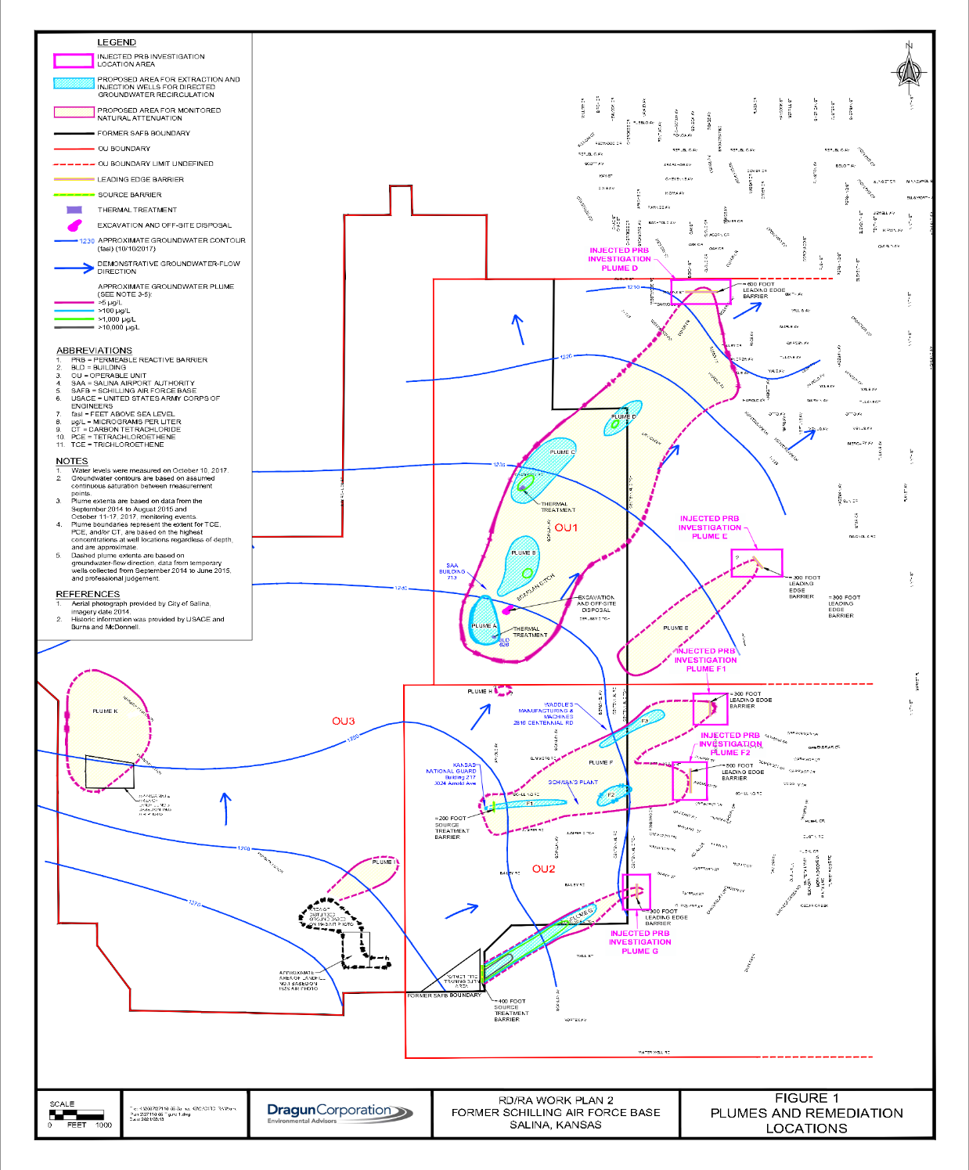
DRAGUN REMEDIAL DESIGN
Additional Investigations
  Refine delineation of each of the plumes/source area
  Optimize each proposed remediation process
D
C
Chemicals of Concern
  TCE
  CT
  PCE
B
E
A
K
H
Other Chemicals
  Chloroform
  1,2 DCE
  VC
F
I
J
G
11 Plumes A-K

Slide 33
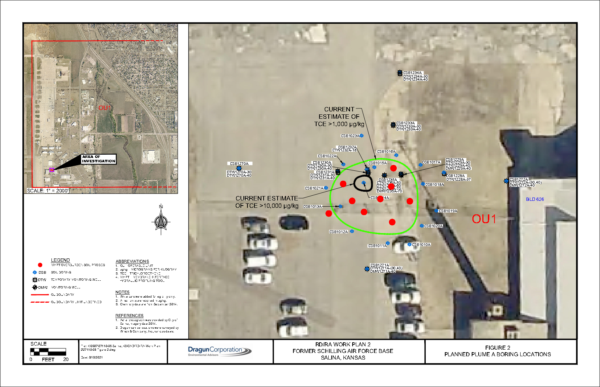
DRAGUN REMEDIAL DESIGN
Plume A source area (near SAA)
  In situ thermal desorption (ISTD)
  TCE exceeds 500,000 (µg/kg)
  Lesser concentrations: CT, chloroform, PCE, DCE and VC
  9 Membrane interface / hydraulic profiling tool (MiHpt)
    Continuous vertical indication of total VOC’s in soil and groundwater
    Continuous vertical indication of permeability in soil
    Geoprobe tool – Salina, KS
R

Slide 34
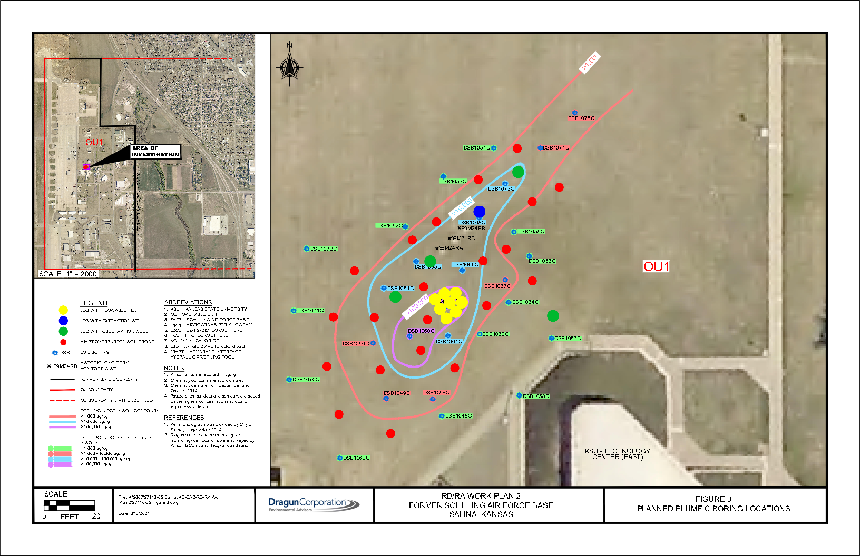
DRAGUN REMEDIAL DESIGN
Plume C source area (near KSU Technology Center)
  ISTD
  TCE exceeds 150,000 µg/kg
  Lesser concentrations: CT, chloroform, PCE, DCE and VC
  21 MiHpt

Slide 35
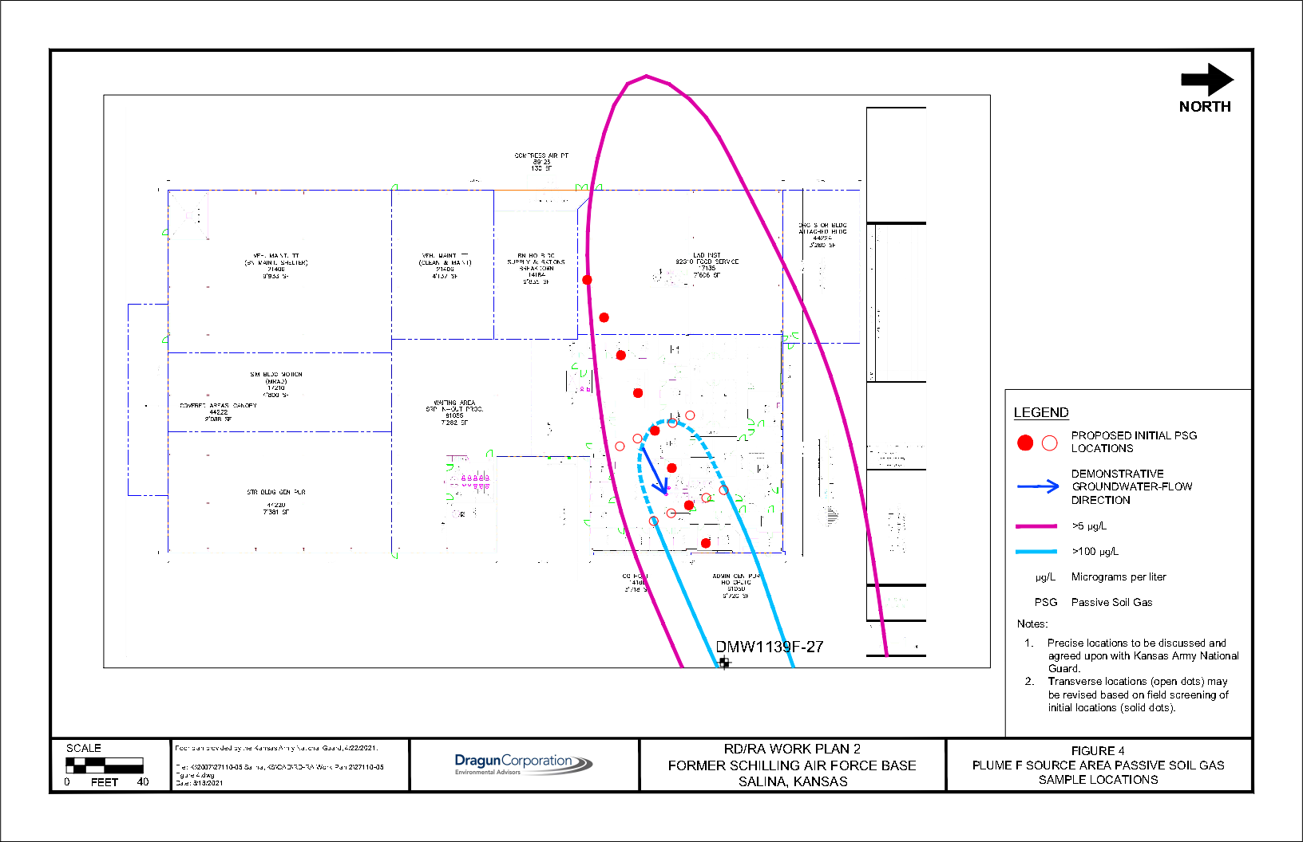
DRAGUN REMEDIAL DESIGN
Plume F source area (near Kansas Army National Guard)
  Emplaced permeable reactive barrier (PRB)
  CT exceeds 942 µg/L in groundwater
  TCE exceeds 70 µg/L in groundwater
  Lesser concentrations: chloroform and DCE
  16 Passive soil gas samplers

Slide 36
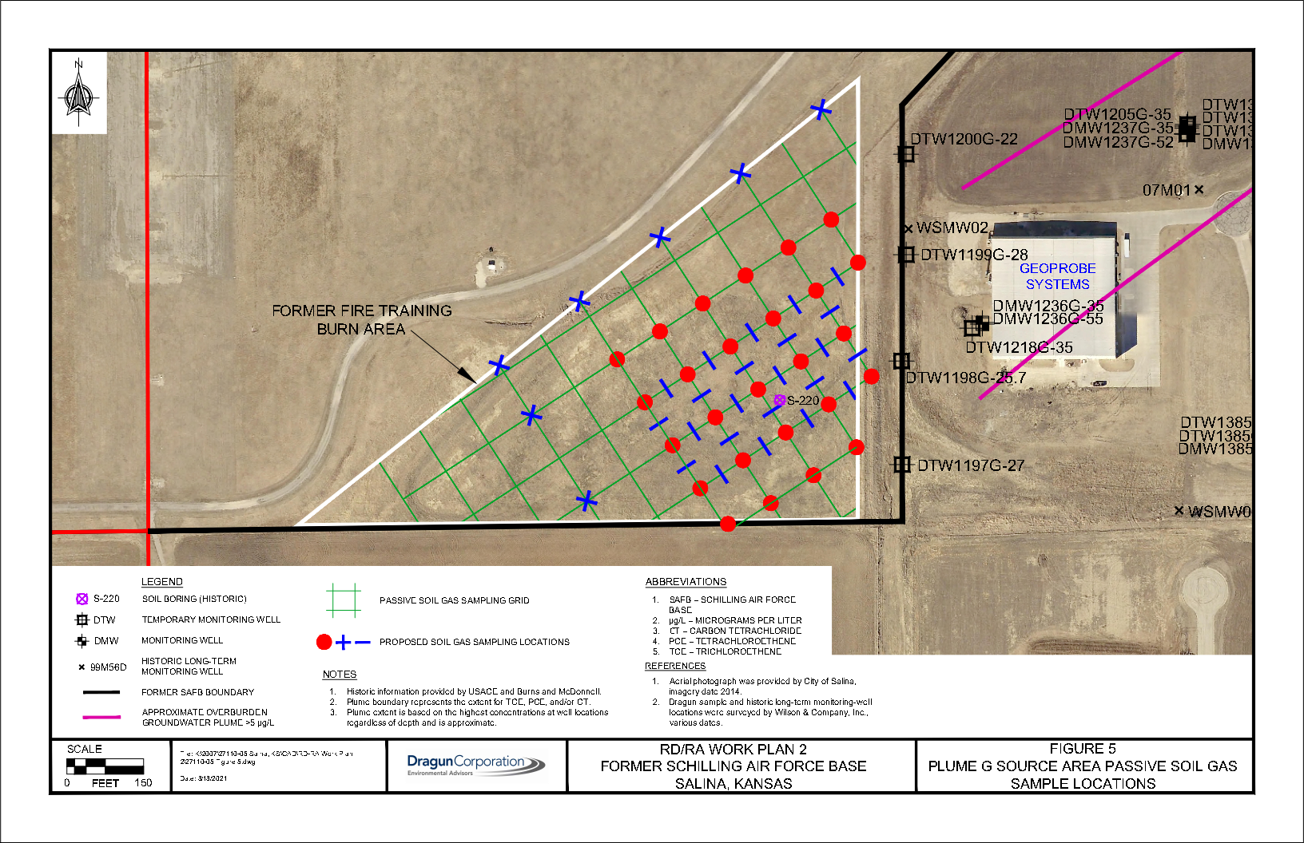
DRAGUN REMEDIAL DESIGN
Plume G source area (near former fire burning training area)
  Emplaced PRB
  TCE exceeds 19,200 µg/L in groundwater
  CT exceeds 22,000 µg/L in groundwater
  TCE exceeds 1, 150 µg/L in bedrock
  CT exceeds 1, 197 µg/L in bedrock

Slide 37
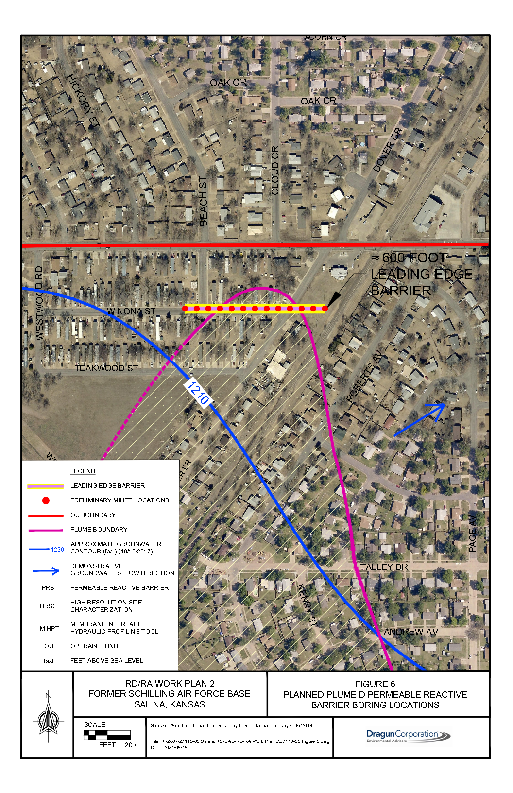
DRAGUN REMEDIAL DESIGN
Plume D
  Originates at Liquid Oxygen Plan
  Leading edge (residential area)
  3,000 ft.
  Injected PRB at Leading edge
  TCE, PCE, CT
  MiHpt
    600 ft. perpendicular to groundwater flow
    50 ft. spacing

Slide 38
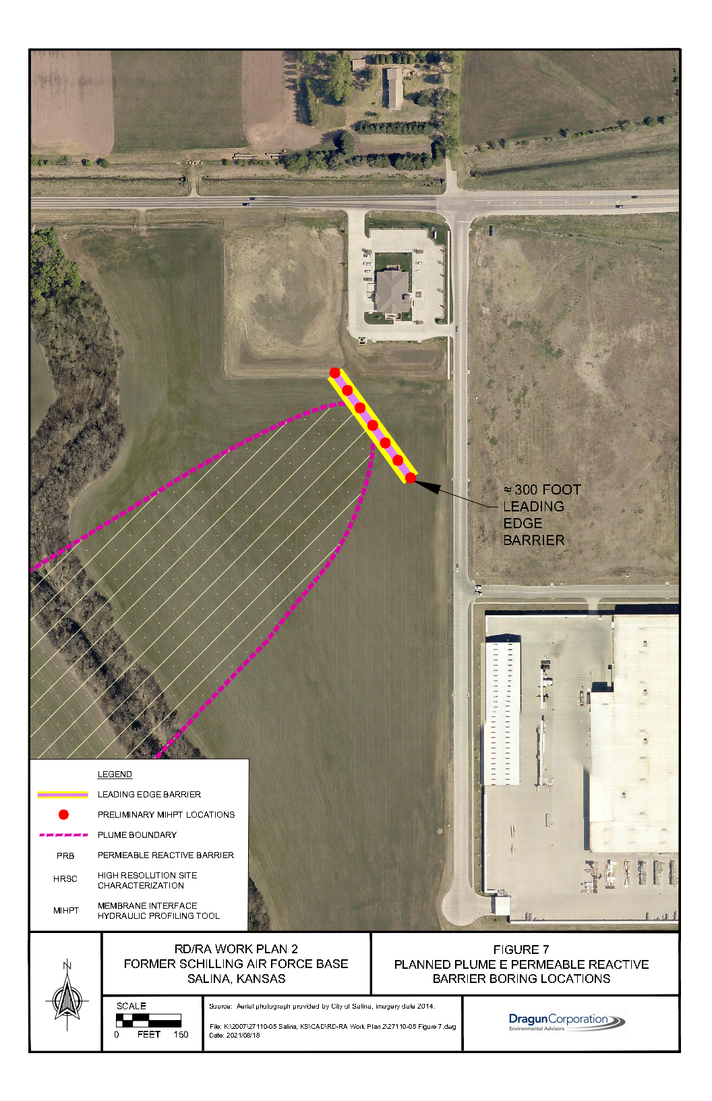
DRAGUN REMEDIAL DESIGN
Plume E
  Originates at former sewage treatment plant area
  Leading edge under Dry Creek near private domestic wells
  3200 ft.
  Injected PRB at Leading edge
  TCE, PCE, CT
  MiHpt
    300 ft. perpendicular to groundwater flow
    50 ft. spacing

Slide 39
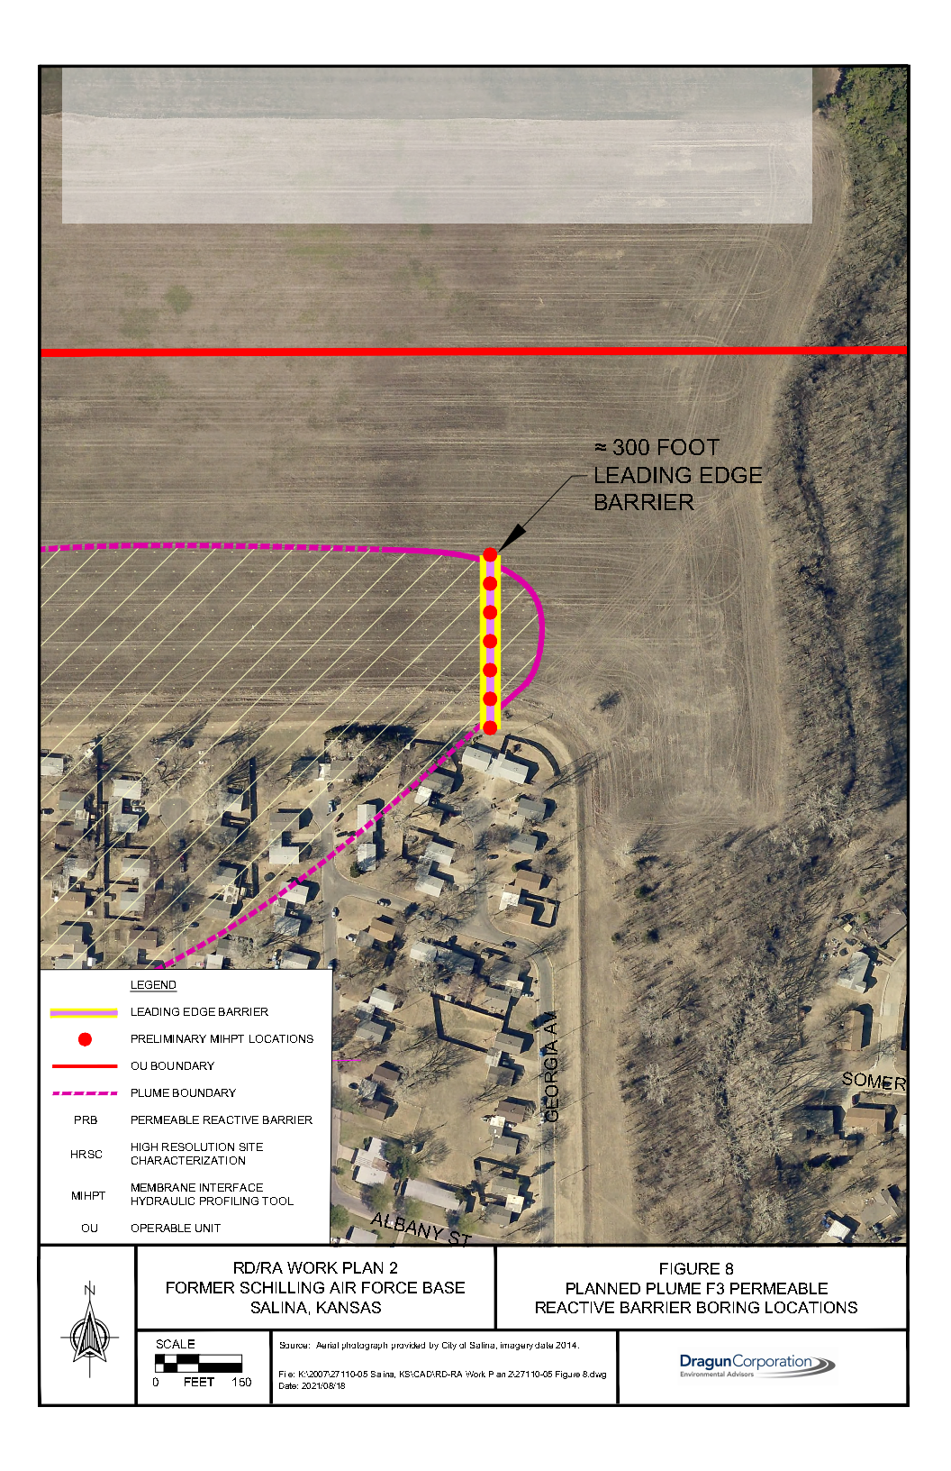
DRAGUN REMEDIAL DESIGN
Plume F3
  Originates on Centennial Rd. and Summer Rd.
  Leading edge in residential area
  5,000 ft.
  Injected PRB at leading edge
  TCE, PCE, CT
  MiHpt
    300 ft. perpendicular to groundwater flow
    50 ft. spacing

Slide 40
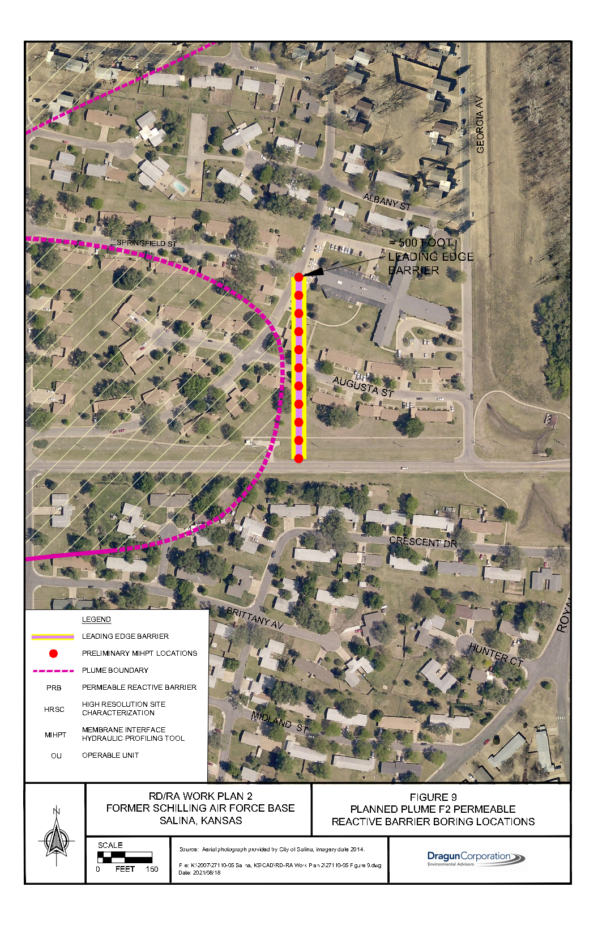
DRAGUN REMEDIAL DESIGN
Plume F2
  Originates near National Guard Building
  Leading edge in residential area
  800 ft.
  Injected PRB at leading edge
  TCE, PCE, CT
  MiHpt
    500 ft. perpendicular to groundwater flow
    50 ft. spacing

Slide 41
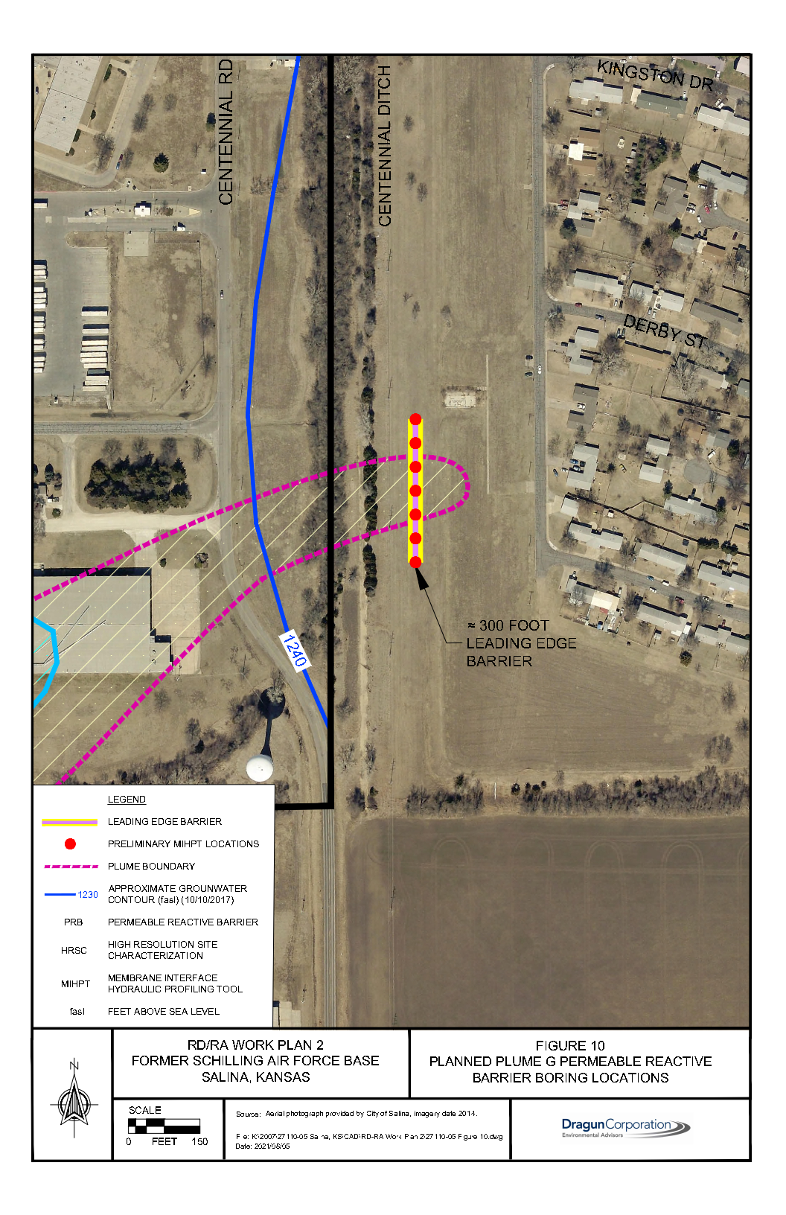
DRAGUN REMEDIAL DESIGN
Plume G
  Originates at former fire training burn area
  Leading edge at centennial ditch and residential area
  3,000 ft.
  Injected PRB at leading edge
  TCE and CT
  MiHpt
    300 ft. perpendicular to groundwater flow
    50 ft. spacing

Slide 42
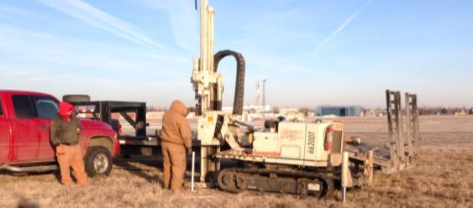
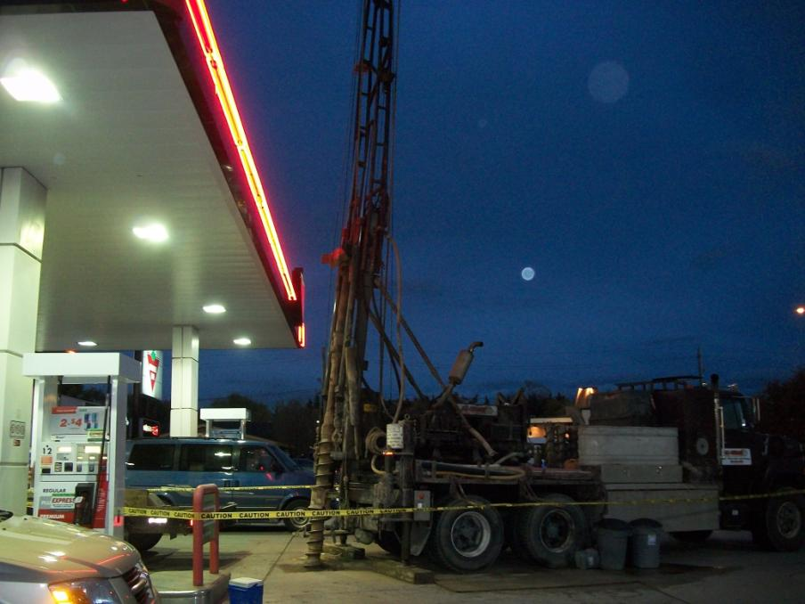
DRAGUN REMEDIAL DESIGN
Plumes A-D, E, F1,F2,F3 and G
  Directed groundwater recirculation (DGR)
  Review existing data
  HPT to identify permeable zones
  Install test wells
  Extraction step tests at extraction wells
  Injection step tests at injection wells

Slide 43
DRAGUN REMEDIAL DESIGN
Additional Investigation Proposed Schedule
Week 1: August 23, 2021 - Week 17: December 13, 2021

Slide 44


WHAT’S NEXT???
WE BUILD!!!

Slide 45
DISCUSSION/QUESTIONS??
Thank you for attending!
If you wish to contact me:
martha.tasker@salina.org

